Slide 1

Box Office Predictions
a CHED Production

Slide 2

Challenge: Predict the Worldwide Box Office Revenue
Dataset: 7300+ Movies
Data Points: Cast, Crew, Plot Keywords, Budget, Posters, Release Dates, Languages, Production Companies, and Countries
Award Criteria: Evaluated on Root-Mean-Squared-Logarithmic-Error (RMSLE) between the predicted value and the actual revenue
Footnote: CHED team also submitting analysis in contest hosted by Kaggle. The competition will conclude May 30, 2019 at 11:59 PM UTC. Kernel Swag goes to the top three most upvoted kernels.

Slide 3

ESTABLISHING SHOT
TASK TOOLS TARGET
Clean Data: Python & Pandas Parse grouped data into singular columns, organize and output to clean CSV file
Line Charts: Tableau Compare variables to revenue over fixed period of time
Scatterplots: Python & Pandas Create a scatterplot for each pair of attributes in the data to identify structured relationships between the variables
Star Power: Python & Pandas Apply a weight to the individual variable (var = Cast, Crew, Production Company and Keyword) based on number of times each appeared in a record from the dataset; then calculating the totals of each movie by summing the weighted numbers of each, respective variable per record (movie)

Slide 4
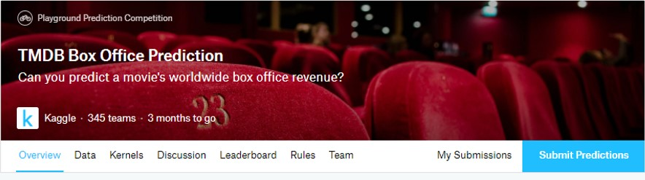
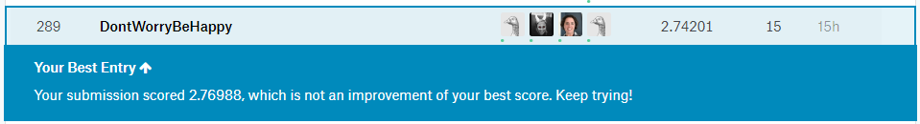
About the Kaggle Competition
Competition Timeline
Start Date: 2/6/2019
Merger Deadline: None
Entry Deadline: None
End Date: 5/30/2019 11:59 PM UTC
Kaggle – Team Name and Members
Hal Marsh
Cindy Pappas
Elizabeth Brown
Dylan Grimm
Competition-Specific Terms
COMPETITION TITLE (the 'Competition'): TMDB Box Office Prediction
COMPETITION SPONSOR: Kaggle
COMPETITION WEBSITE: https://www.kaggle.com/c/tmdb-box-office-prediction
PRIZES: Swag
WINNER LICENSE TYPE: none

Slide 5
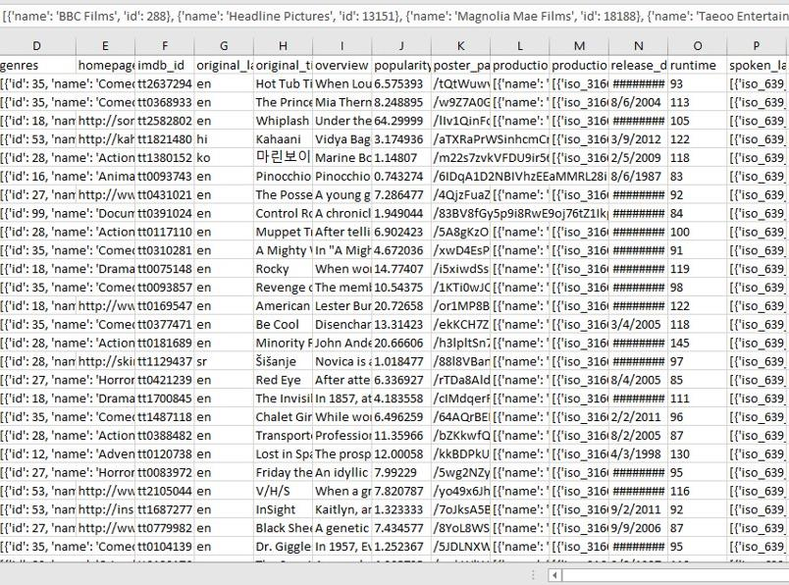
Data Cleaning
Challenges
Many columns held lists of information that had to be parsed out
Some of the data was in other languages
Large number of non-alphanumeric characters

Slide 6

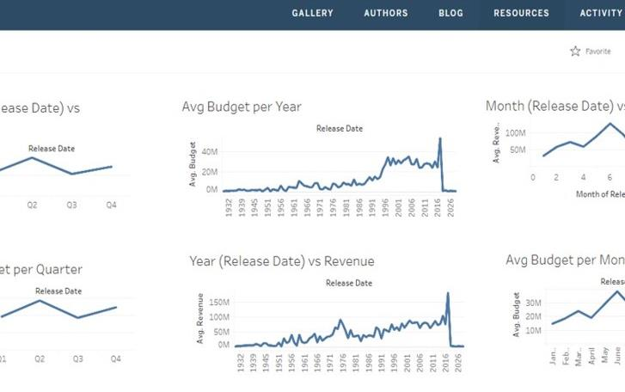
TABLEAU PUBLIC
For Quick Data Comparisons
We used Tableau Public to compare data points to the revenue by using line charts to identify similarities in time-based trends

Slide 7
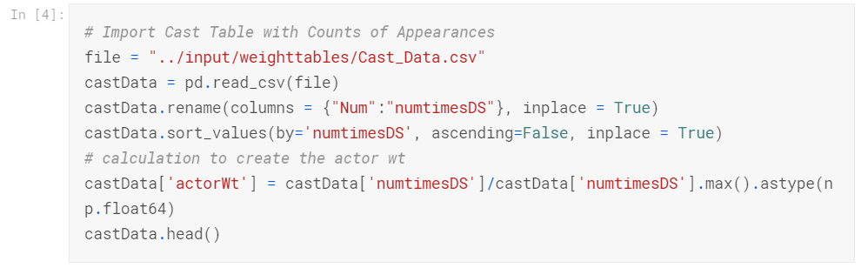
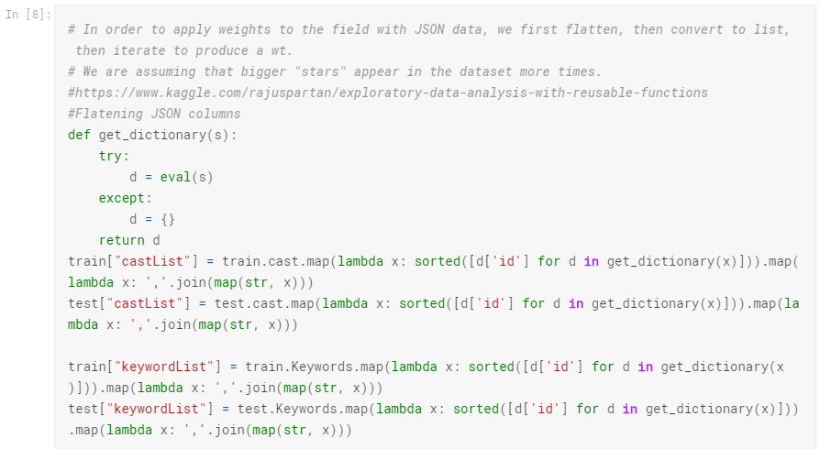
Assigning weights to Cast, Crew, Production Companies, and Keyword by number of appearances¶
Similar to scalers used for ML models later, we decided to weight the cast, crew, and keywords by number of appearances in the dataset. We created tables of the unique values, then assigned a weight over the range.

Slide 8
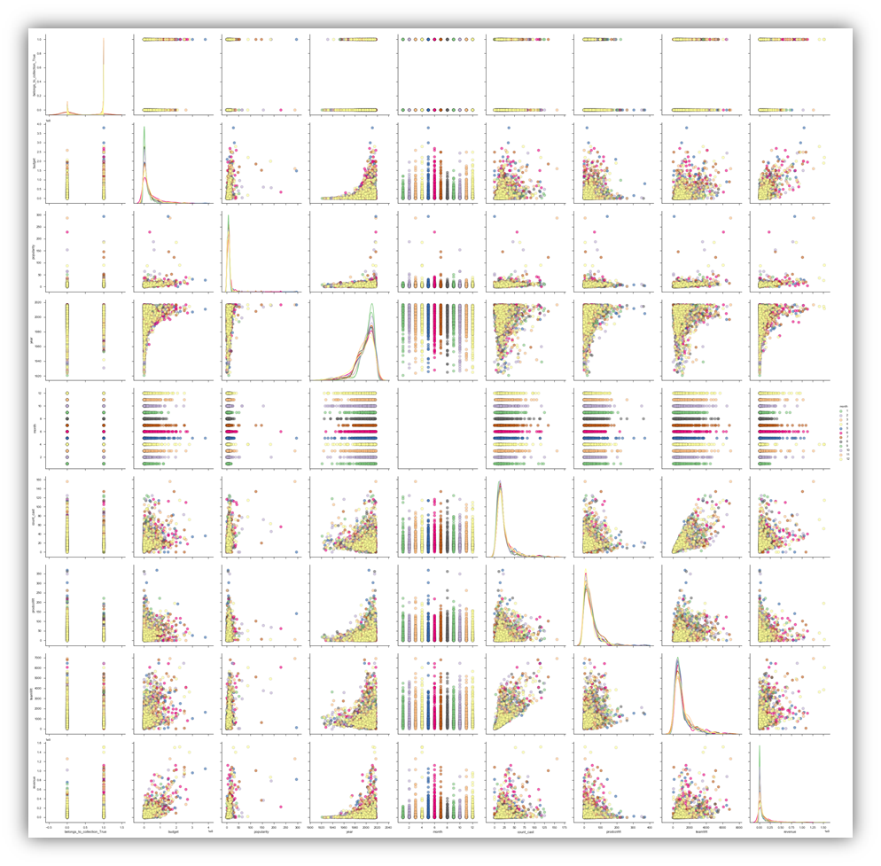

Production Design
We used scatterplot matrices to identify relationships between pairs of attributes.
Assumptions:
Bigger “Stars” appear in the dataset more times

Slide 9
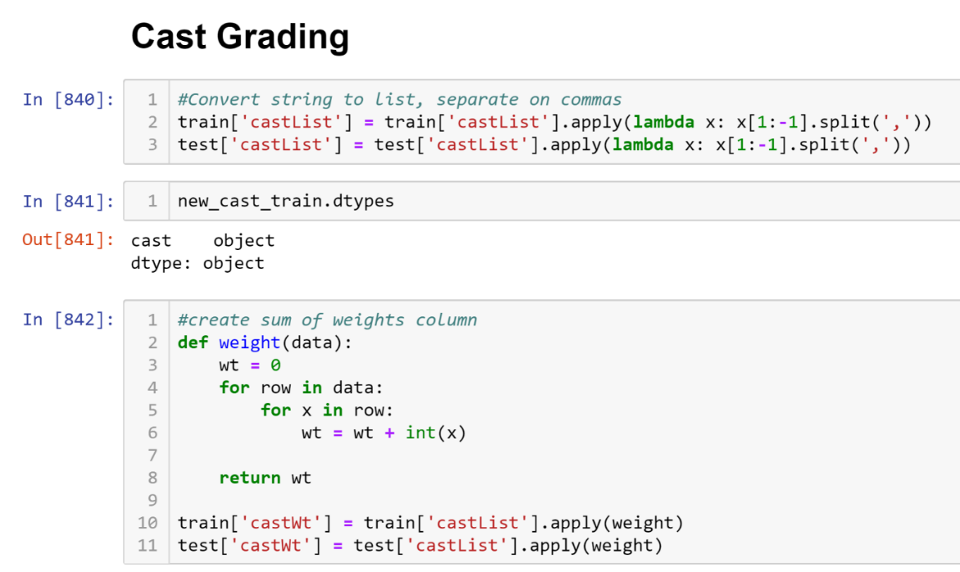

Star
Power

Slide 10
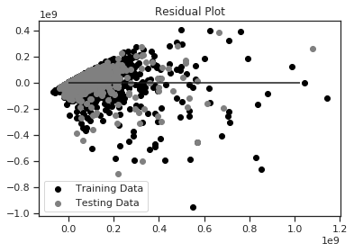
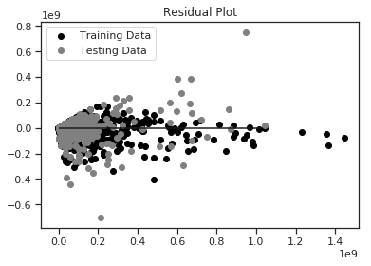
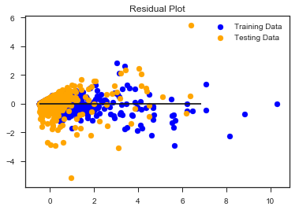
MACHINE LEARNING MODELS
Linear Regression
Gradient Boosting Regressor
Random Forest
No Scaler:
MSE: 6479900234022055.0
R2: 0.6142119862162412
With Scaler:
MSE: 0.3034213095384934
R2: 0.645796572169355
No Scaler:
MSE: 5941429754439809.0
R2: 0.6462704206514704
With Scaler:
MSE: 0.3304776155221138
R2: 0.6142119865698477
No Scaler:
With Scaler:
MSE: 0.34180961661481335
R2: 0.600983404710123

Slide 11

Advance Screening

Slide 12




Slide 13

Credits

